Slide 1
Active learning to detect DDoS attack using ranked features Jul 2019 Computer Communications 31 citations
Rohullah Jahanafrooz
1401/10/13

Slide 2
Problem
Challenges: High-Bandwidth networks ➔ high-dimensional datasets ➔ Variety of traffic characteristics/pattern ➔ feature extraction is difficult ➔ traffic classification ➔ defense
Traffic Classification approaches:
Port-based: fast but not so accurate
DPI: accurate but time-consuming
Statistical Approaches: uses packet headers
Supervised Machine Learning: time-consuming to train with labled datasets
Semi Supervised: Active Learning: training dataset is repeatedly updated by a learning process that analyzes unlabeled samples to select most informative patterns by use of an expert that assign labels to them.
Goal: Adaptive traffic Active Learning classification with minimum Adaptive training dataset

Slide 3
Brief
Distributed feature selection in IDS using parallel computing
Our method
feature-ranking algorithm is needed
Active Learning approach for selecting lowest appropriate samples (dynamic) to train SVM binary classifier. (semi-supervised: means an expert needed to label unlabeled data) (dynamic classifier)

Slide 4
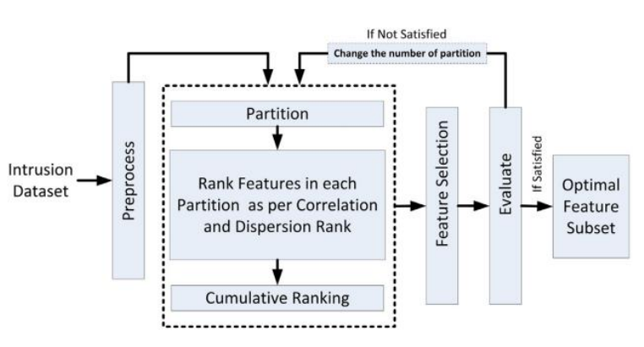
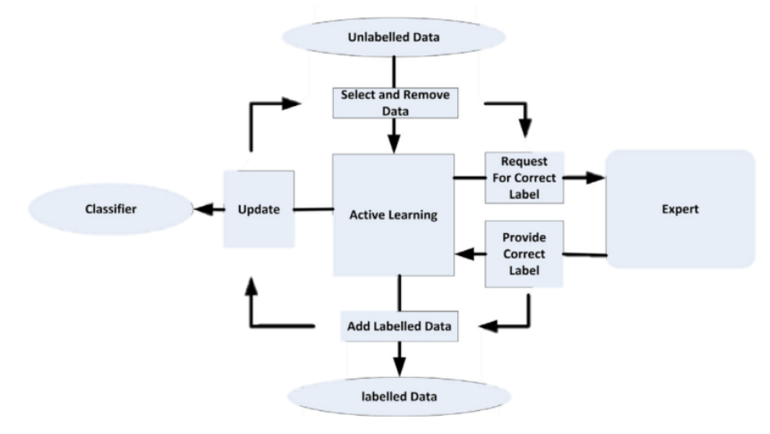
Components
Parallel Cumulative Rank: ranks the attributes of a dataset for cost-effective classification of network traffic
Active learning to select the appropriate instances by an expert module in an unsupervised way to train SVM binary classifier

Slide 5
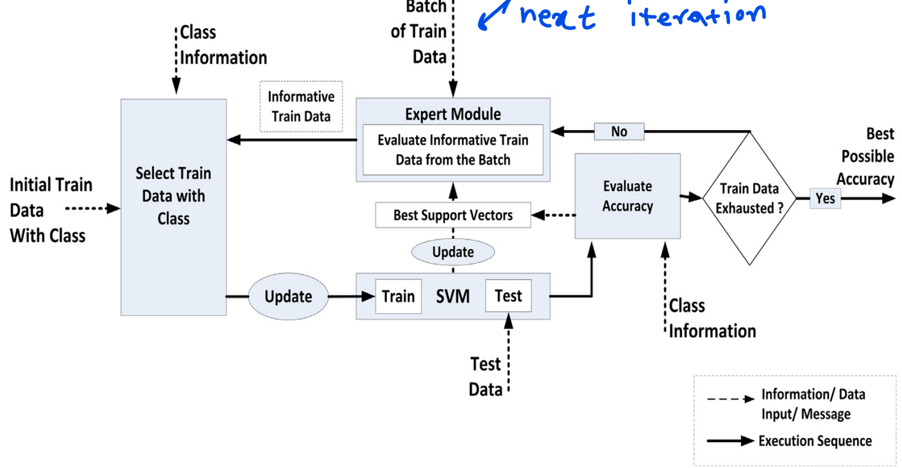
Framework

Slide 6
Evaluation
Four datasets and see that the best possible features accuracy for parallel is much higher than sequential environment
we have evaluate five different DL classifier

Slide 7
Relation
Which component of our architecture? With a classifier it does our entire job.
Which problem it solve? Best way to train a classifier in high-bandiwdth
Why to use it? Low latency for training
Draw it in picture:

